Slide 1

A-IoT : Work Package: Cabin Air Quality Monitoring August 2019
IISc Team
Indian Institute of Science, Bangalore

Slide 2
Data generation architecture with Neural Network and Controller
Data generation model
GUI
Fr,X
Suffocation model for CO2
ECS Simulink model (TPH)
Passenger Count.
Anomalous conditions
Fr
Flowrate(Fr),
Bleed- Recirculated Air ratio(X)
Humidity, Temperature, Pressure
Passenger count
Set point
CO2[1:6]
Chronograf
Controller
Neural network (detect root cause)
Anomaly class
InfluxDB

Slide 3
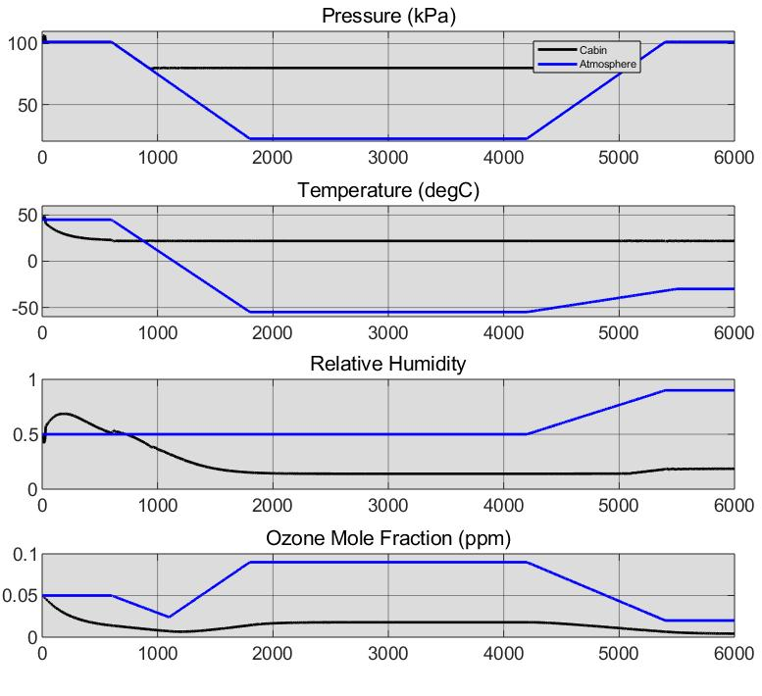
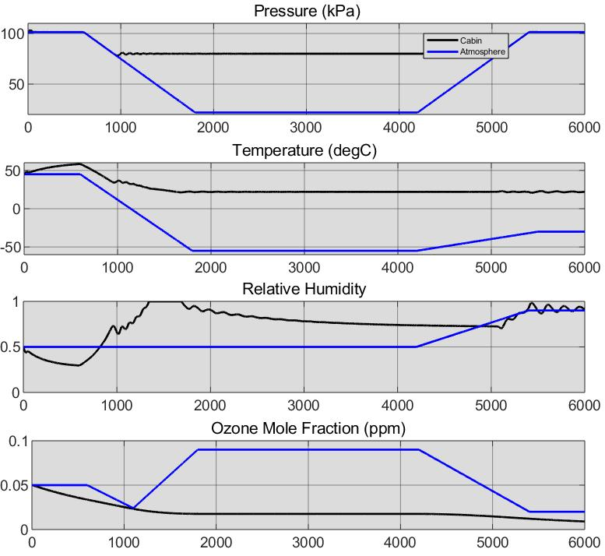
Change in cabin parameters due to variation in flow rate
Scale,
X-axis:
1 unit = 1000 seconds
Y-axis :
1 unit = 1 units of signal
Signals
Time (Seconds)
Fig. ECS parameter for Normal ventilation efficiency inside cabin
Fig. ECS parameter for Anomalous ventilation efficiency inside cabin
[Source: Simulink( MATLAB ECS)]

Slide 4

Neural Network augmented Control system
CLASS | DESCRIPTION | CONTROL ACTION
0 | No anomaly | NA
1 | Ventilation Efficiency | Increase Flowrate, Do not alter bleed-recirculation ratio (0.5).
2 | Internal Independent source | Maintain Flowrate, Increase bleed-recirculation ratio to 0.7
3 | External event | Maintain Flowrate, Increase bleed-recirculation ratio to 0.2
4 | Normal Conditions being restored | Maintain Flowrate, Increase bleed-recirculation ratio to 0.6
Temperature | Pressure | Humidity | Passenger Count
CO₂ across zones (1:6) | Rate of CO2 rise (1:6) | Deviation of zone from mean (1:6)
Neural Network
Input Parameters For The Neural Network
Output Of The NN
Class0 Class1 Class2 Class3 Class4
The neural net has 22 input and 5 output neurons.
There are 4 hidden layers with 20,20,20 and 15 neurons sequentially.
A 70/30 training validation split is done over 332402 data frames.
The frame rate is 1/Sec and a total of 92 hrs of flight data is used for training and validation.
Confusion Matrix

Slide 5
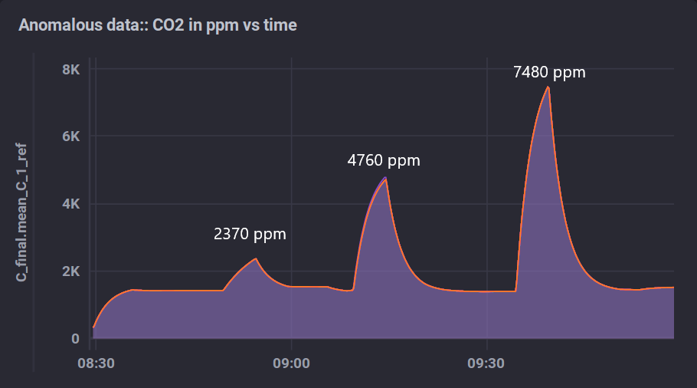
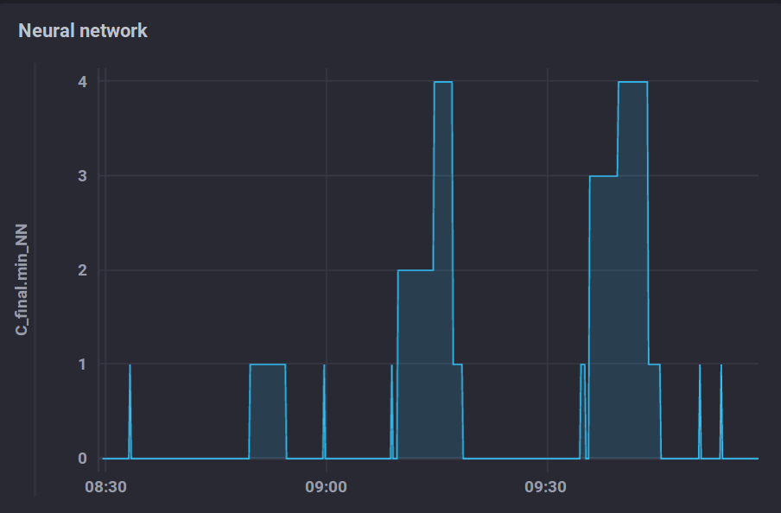
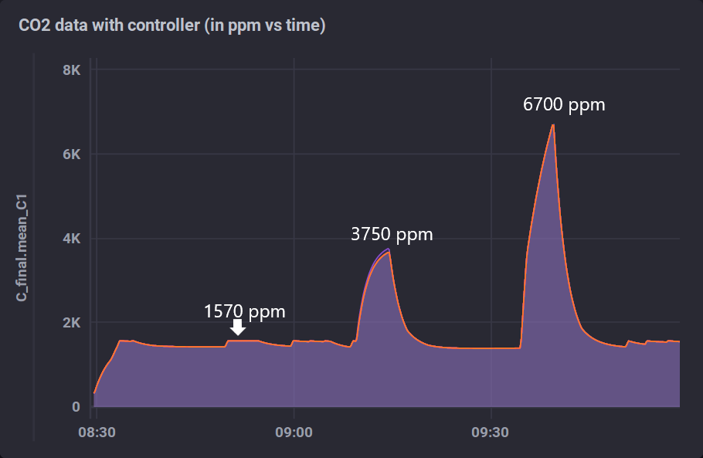
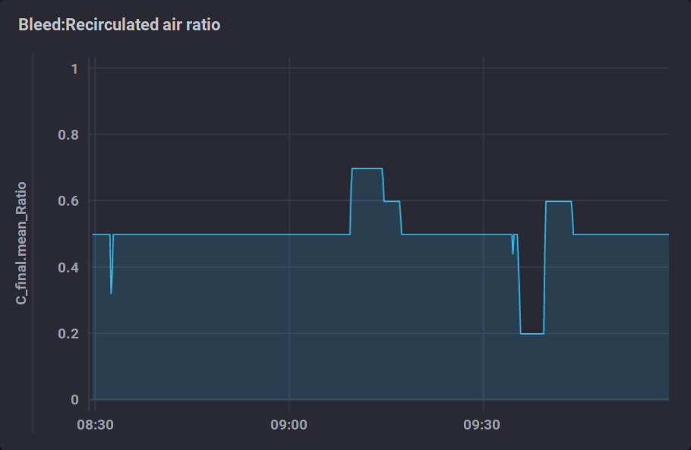
Results for Class 1,2 and 3 anomalies for 75% occupancy

Slide 6
Thank you
LOOKING FORWARD FOR YOUR SUPPORT

